Slide 1
Analyzing Water Quality and Potability
By Ethan DeVries, Jacob Robinson, Andrew Chisholm, Onat Ayyildiz, Jack Carscadden, and Liam McNulty

Slide 2
01
Introduction
An examination of our data and a look into our goal
Notes:
Andrew

Slide 3
Background
Water potability refers to the safety and suitability of drinking water for human consumption
Access to safe drinking water is a crucial aspect of public health, and contaminated water can cause a range of illnesses
In addition to microbiological contaminants, water can also contain harmful chemicals, including:
Heavy metals (e.g., lead, arsenic, mercury)
Pesticides and herbicides
Chlorine and other disinfection byproducts
Fluoride
Nitrate and nitrite
Notes:
Andrew

Slide 4
The Data
The data contains over 3000 data points. In addition to the binary variable determining the potability of water, our dataset contains the following characteristics of water:
pH
Hardness
Solids
Chloramines
Sulfate
Conductivity
Organic Carbon
Trihalomethanes
Turbidity
Notes:
Ethan

Slide 5
Purpose
The purpose of the project is to create a model/method that can accurately predict the potability of a water sample given the variables in the dataset.
The model should be able to classify a random water sample that is not included in the dataset.
The project will use machine learning algorithms to create the model.
The accuracy of the model will be evaluated using various performance metrics.
Notes:
Ethan

Slide 6
02
Methods
How we analyzed our data

Slide 7
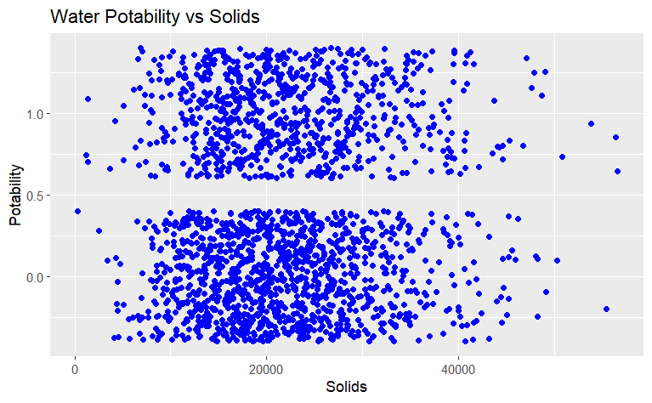
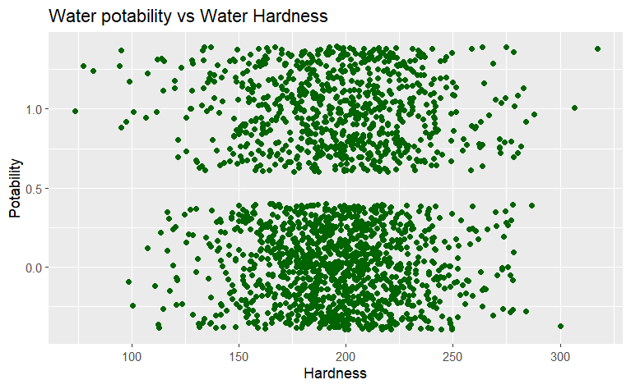
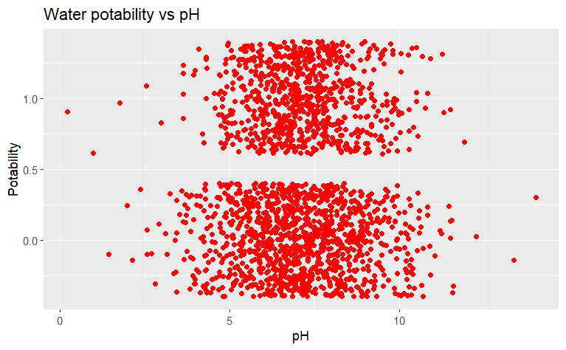
Plotting against Potability
First, we directly analyzed the relationship between different variables and potability through visualizations.
By plotting these, we were able to get a visual representation of the relationship between these variables
There was seemingly no correlation between any of the three and potability, suggesting a model with interaction between variables, and including multiple variables, was going to be needed
Notes:
Jacob

Slide 8
Linear Modeling
A step function was used to identify the most significant factor.
Solids was the most significant variable.
A model was created using Solids as the predictor variable.
However, when the accuracy of the model was evaluated using the r-squared value of 0.001157, it was found to be highly inaccurate.
Notes:
Jacob

Slide 9
Machine Learning Algorithms
GLM
60%
90%
K-NN
Random Forest
70%
95%
New Dataset
Statistical learning algorithm for regression and classification tasks.
Non-parametric algorithm for classification and regression tasks.
Ensemble learning method for classification and regression tasks.
Random forest model applied to new dataset.
Notes:
Jacob

Slide 10
GLM Machine Learning
Models the relationship between a dependent and independent variables.
Uses link function to transform the response variable to a linear function of the predictor variables.
A probability distribution is used to model the linear function.
The link function allows for modeling of non-linear relationships.
Model parameters are estimated using maximum likelihood estimation.
Notes:
Onat

Slide 11
K-NN Machine Learning
Uses a distance metric to find the k-nearest neighbors.
The response of the data point is predicted based on its neighbors.
K determines the number of neighbors used in the prediction.
K-NN is a lazy learner that memorizes the training data.
The choice of distance metric and k can affect performance.
Notes:
Liam

Slide 12
Random Forest Machine Learning
Ensemble algorithm that combines decision trees.
Each tree is constructed using a random subset of the data and features.
Bagging and random feature selection improve performance and reduce overfitting.
Random Forest is non-parametric and robust to noisy features.
Notes:
Jack

Slide 13
03
Results
What our Machine Learning Algorithms yielded

Slide 14
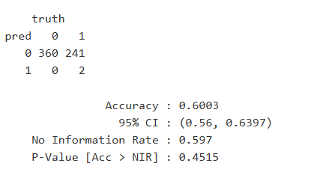
GLM Machine Learning
The GLM model was not very accurate and yielded the following Confusion Matrix:
Notes:
Onat

Slide 15
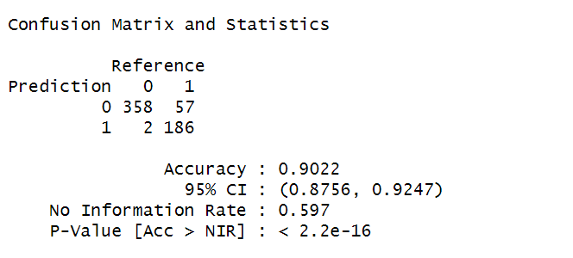
K-NN Machine Learning
The K-NN model was much more accurate and yielded the following Confusion Matrix:
Notes:
Liam

Slide 16
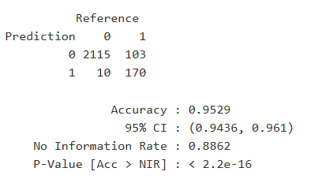
New Dataset (With Random Forest)
We found a new dataset that broke down the Solids and Hardness variables into individual compounds and put it through the Random Forest Classifier:
Notes:
Onat

Slide 17
04
Conclusion
What we can conclude from our results

Slide 18
Deductions
Non-Linear Relationship
Since the Linear Regression and GLM models were not very accurate, it is clear that there may not be a linear relationship between variables
Importance of Solids in Water
Since the new dataset yielded much better results, the constituent compounds of solids clearly play an important role in water potability
Notes:
Jack

Slide 19
Limitations and Critiques
Many NA Values
Not Universal
95% is still Low
Impossible to know if these values affected the predictions
Predictions are not representative of the whole population
Realistically, the potability of a water sample should be predicted with much higher accuracy
Notes:
Jack

Slide 20
References
Kadiwal, A. (2021, April 25). Water quality. Kaggle. Retrieved April 23, 2023, from https://www.kaggle.com/datasets/adityakadiwal/water-potability
MsSmartyPants. (2021, June 30). Water quality. Kaggle. Retrieved April 23, 2023, from https://www.kaggle.com/datasets/mssmartypants/water-quality
Finnstats. (2021, April 13). Random Forest in R: R-bloggers. R. Retrieved April 23, 2023, from https://www.r-bloggers.com/2021/04/random-forest-in-r/
Notes:
Jack

Slide 21
Thank you

